Slide 1
Asymmetric copula in multivariate flood frequency analysis
Hannes Grün, Robin Schüttpelz

Slide 2
Relevance
Floods: Among most severe natural hazards worldwide. Floods in Bavaria in 2024 alone have caused ~ 4 bn € damages. [1]
Multivariate flood analysis: Interdependence of flood event characteristics.
Asymmetric copula functions: Varying strength of dependence between variables, allowing more accurate modelling. [2]
[1] BS 2025 [2] Khajehali et al. 2025

Slide 3
Dependence Structure
Relevant Variables: Flood peak (P), Duration (D), Volume (V).
Influences on Dependencies: P affects dependence structure between D & V.
Goal by Grimaldi & Serinaldi (2006): Trivariate joint distribution of flood event variables using fully nested or asymmetric Archimedean copula functions.
Grimaldi & Serinaldi 2006

Slide 4
Research Question
Reproduction of methodology by Grimaldi & Serinaldi (2006) within in bavarian rivers.
Comparison of nested Archimedean copulas (NACs) with vine copulas for modeling multivariate flood dependencies.
Evaluation of the advantages of flood return periods in a multivariate statistical framework.

Slide 5
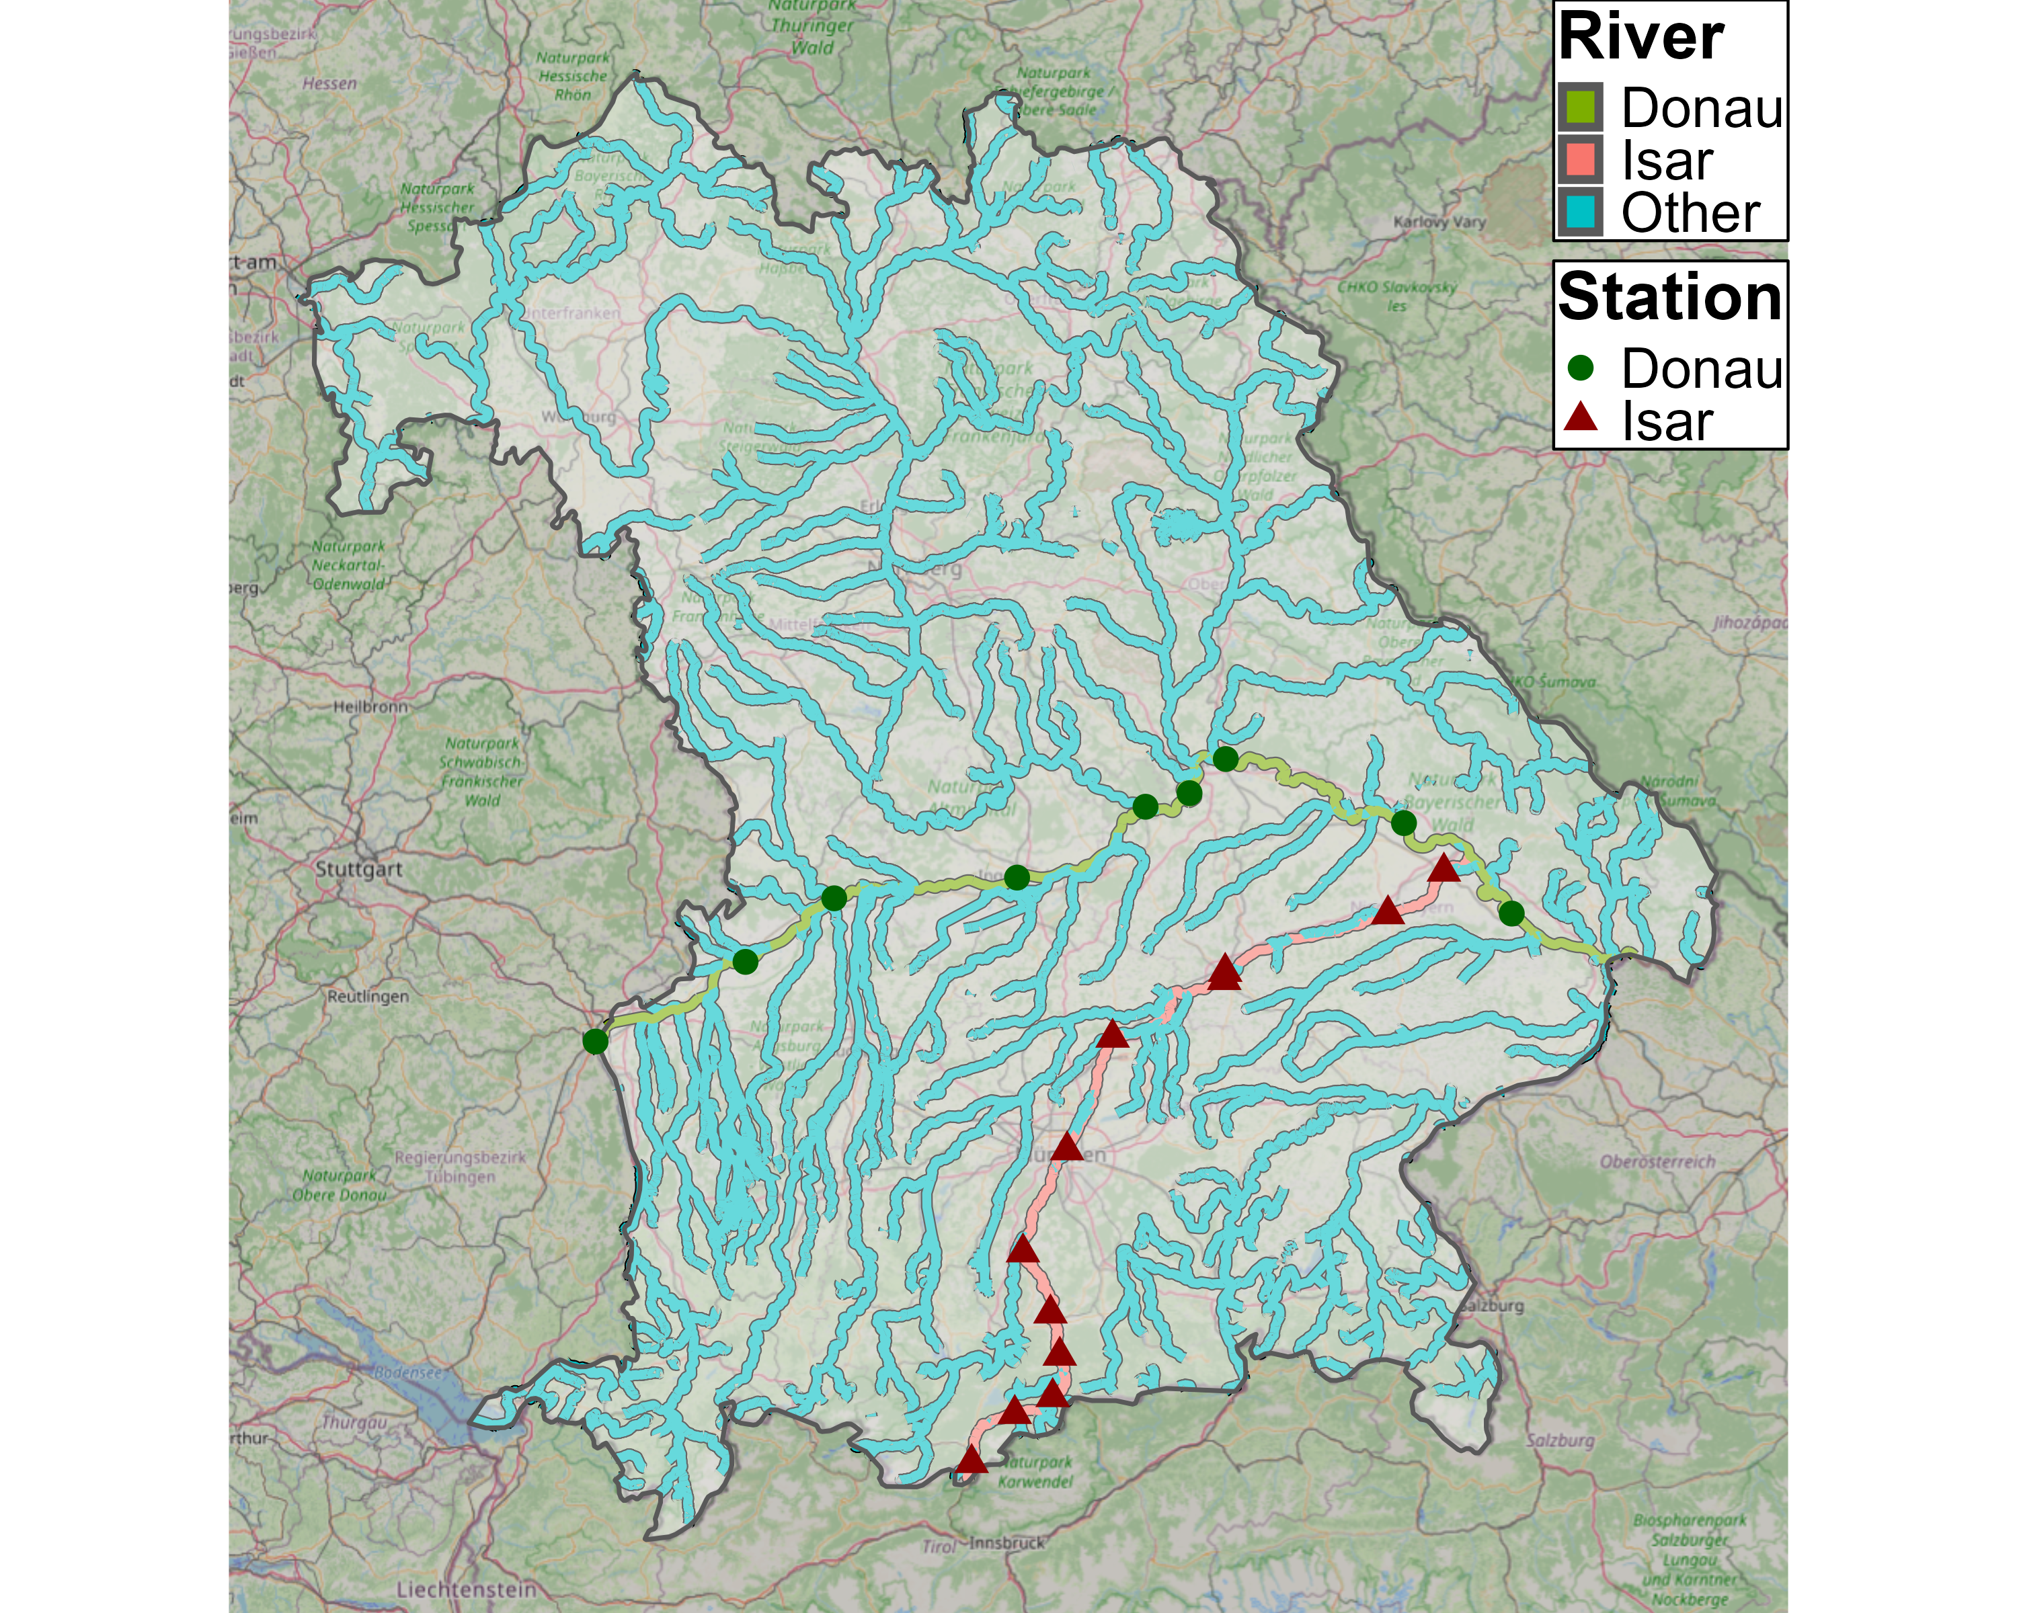
Data - Selection
GKD 2025

Slide 6
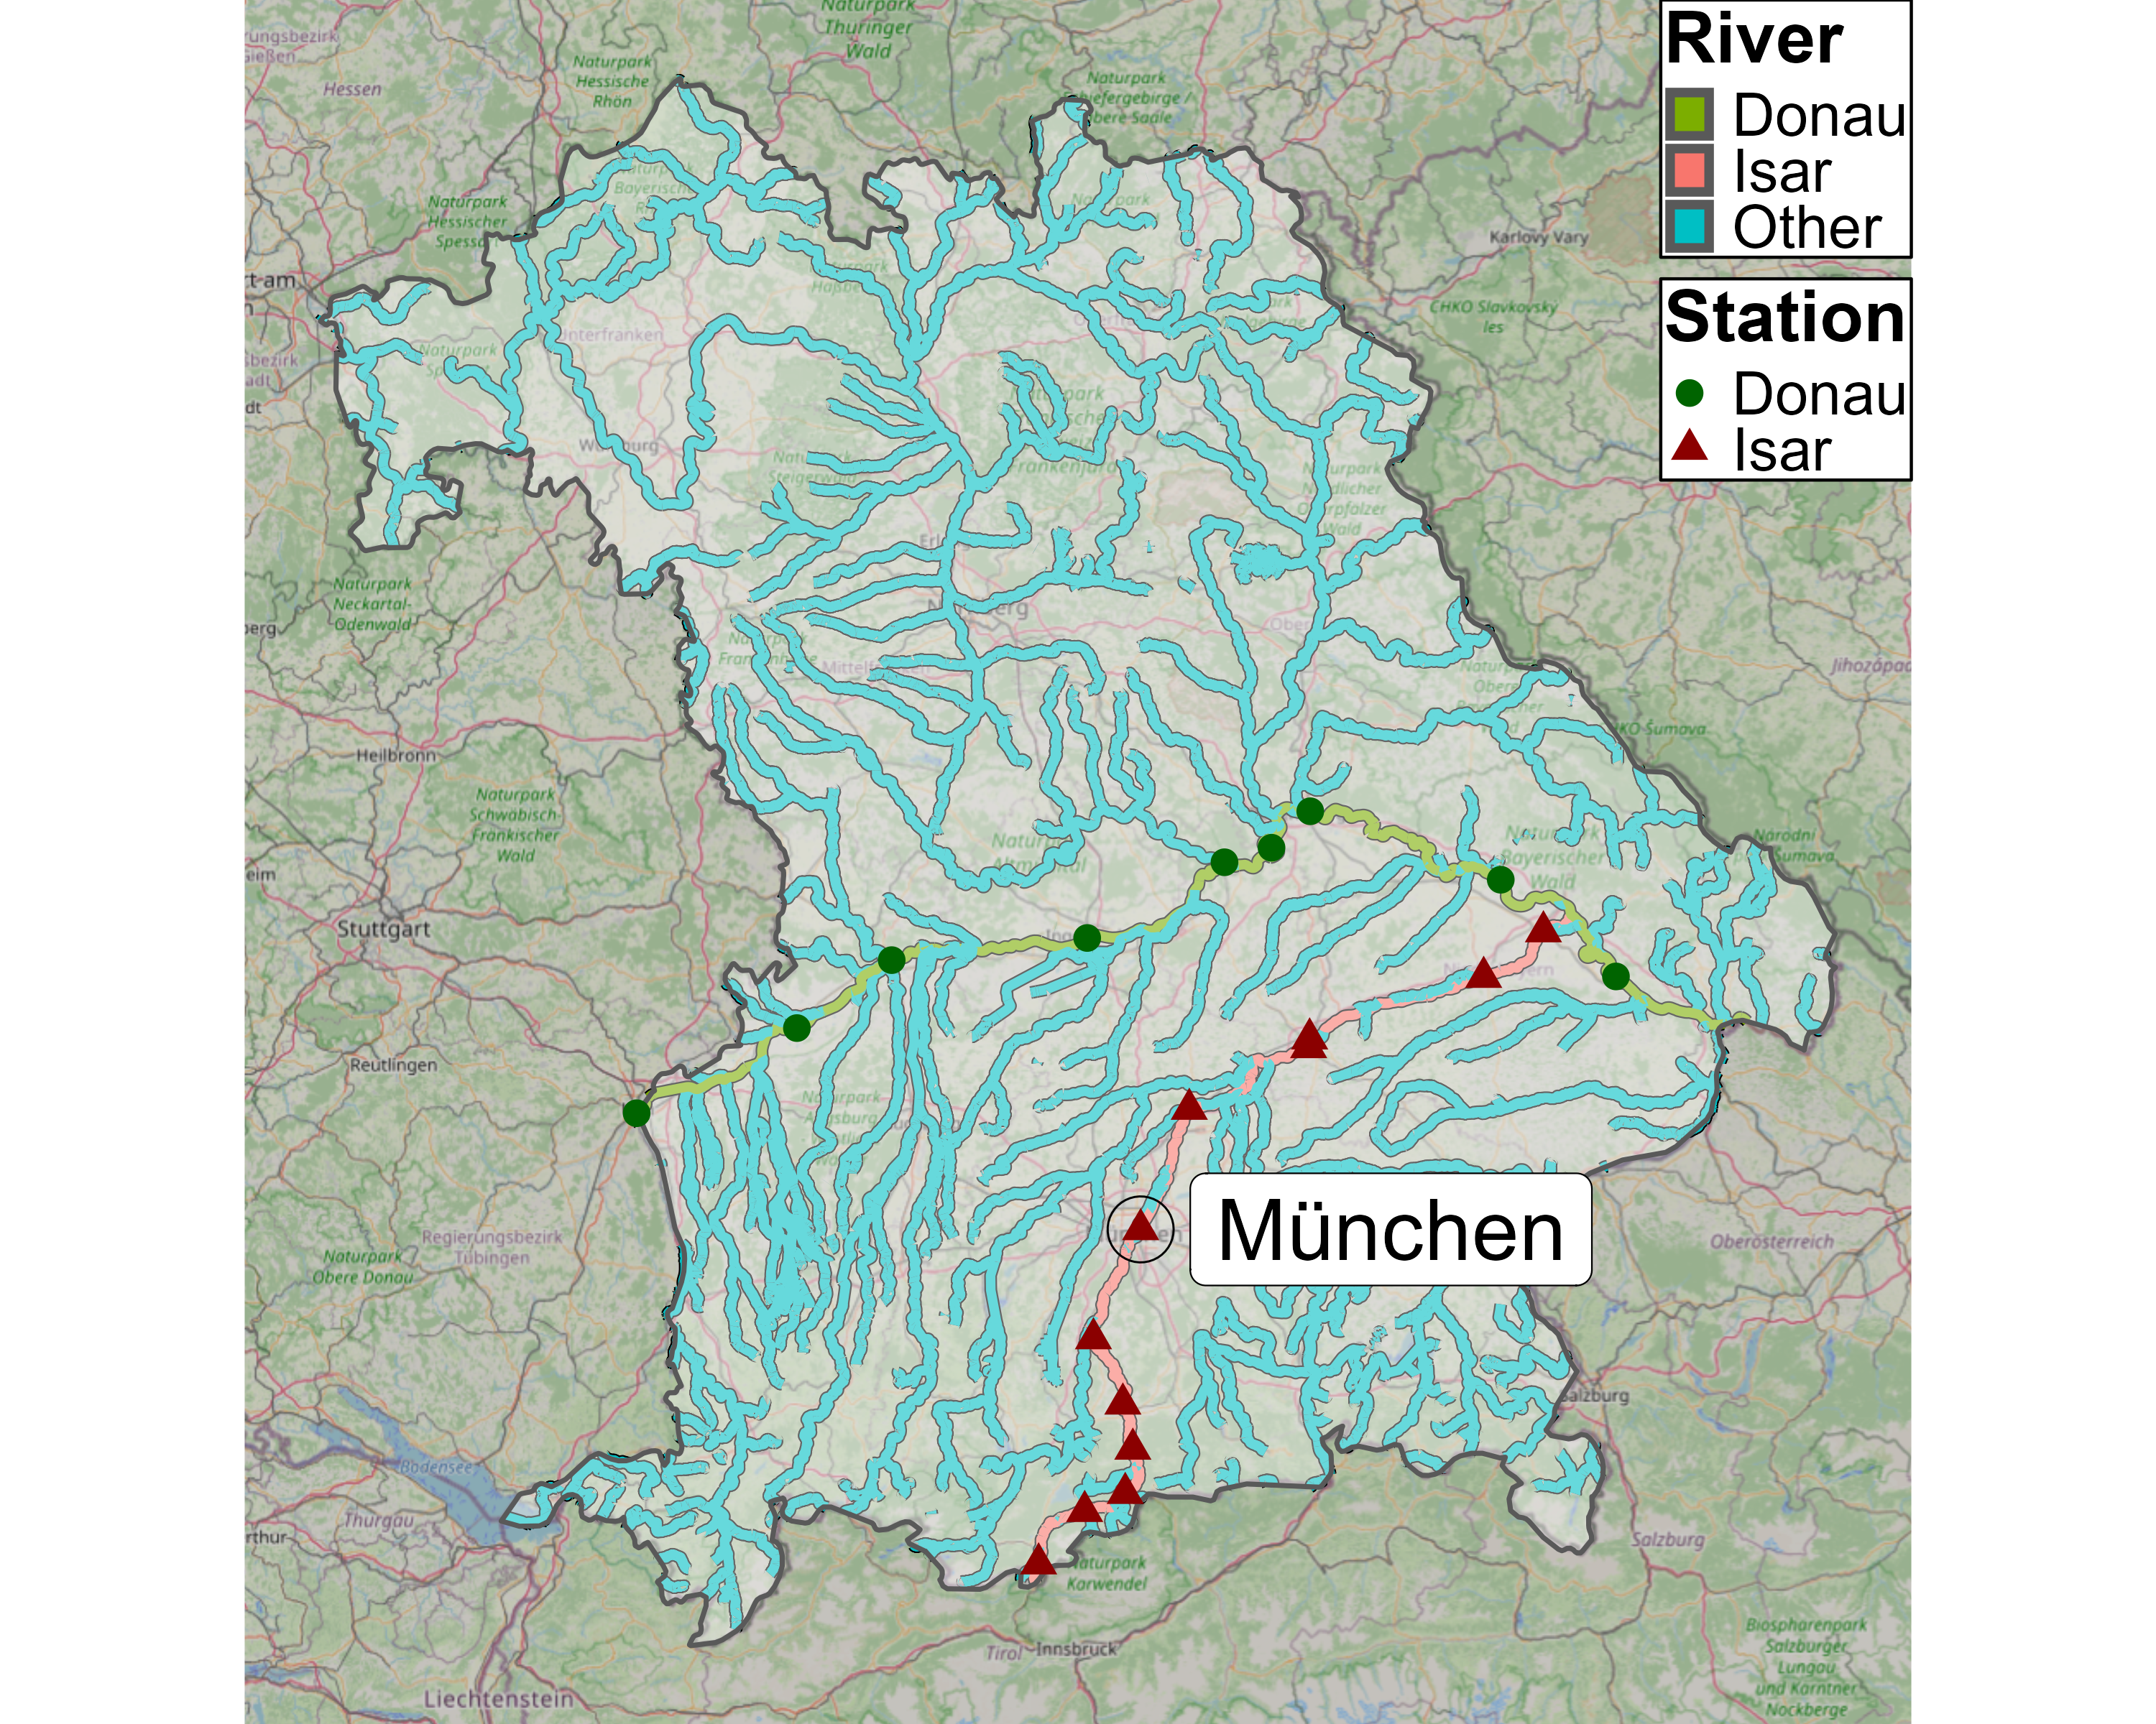
Data - Selection
GKD 2025

Slide 7
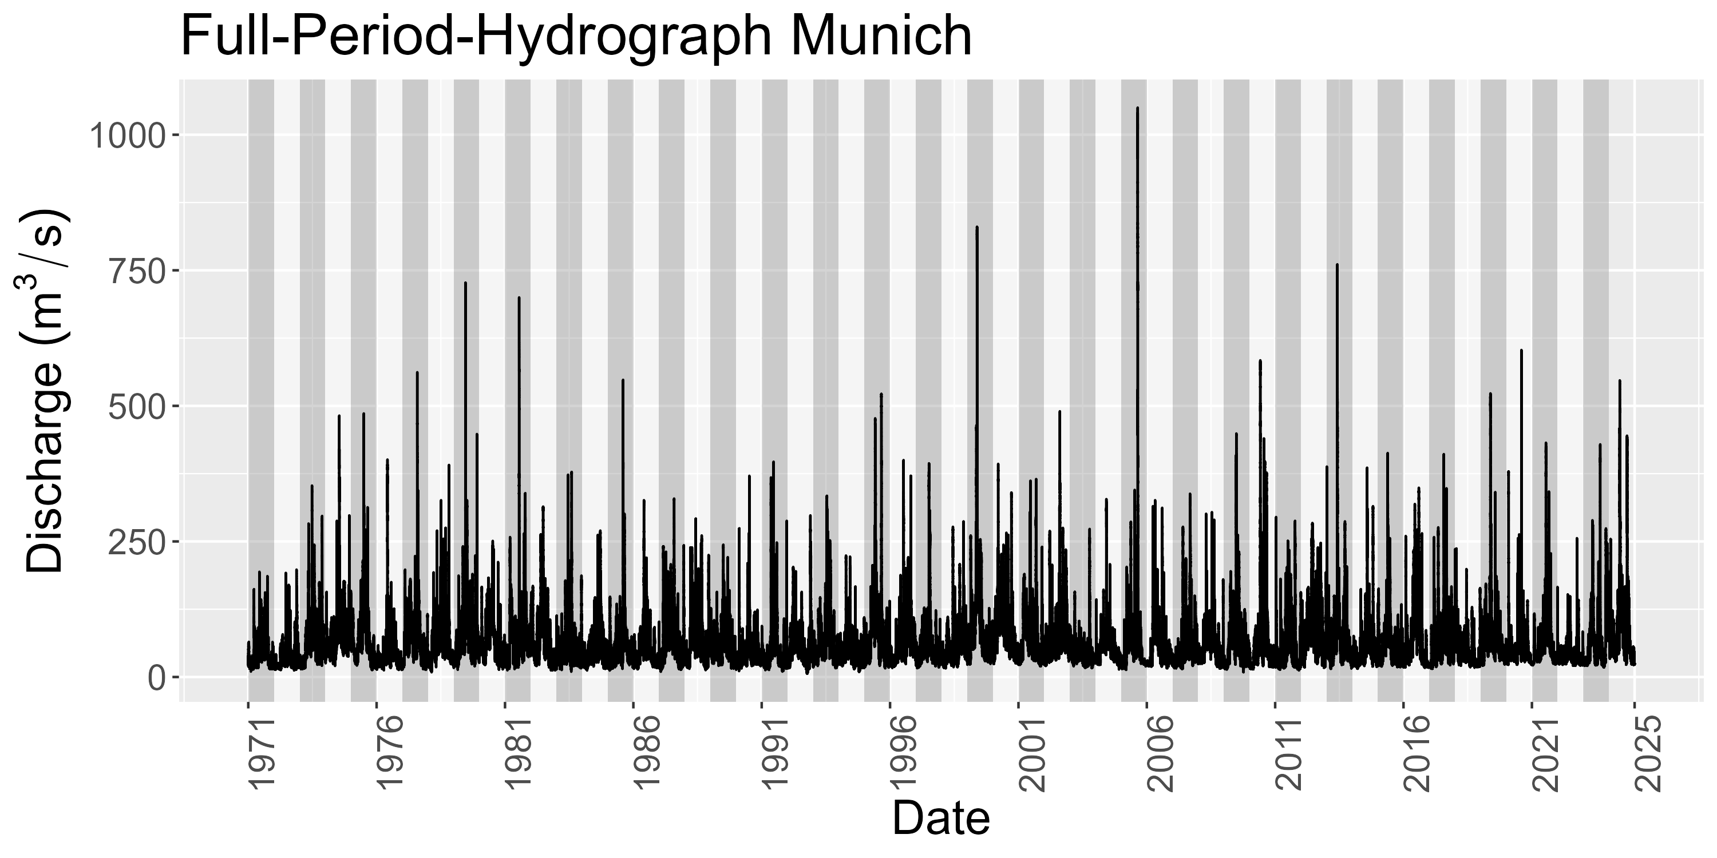
Data – Munich Station
Notes:
Hydrograph over 54 years
See later: number of years are number of observations per station

Slide 8
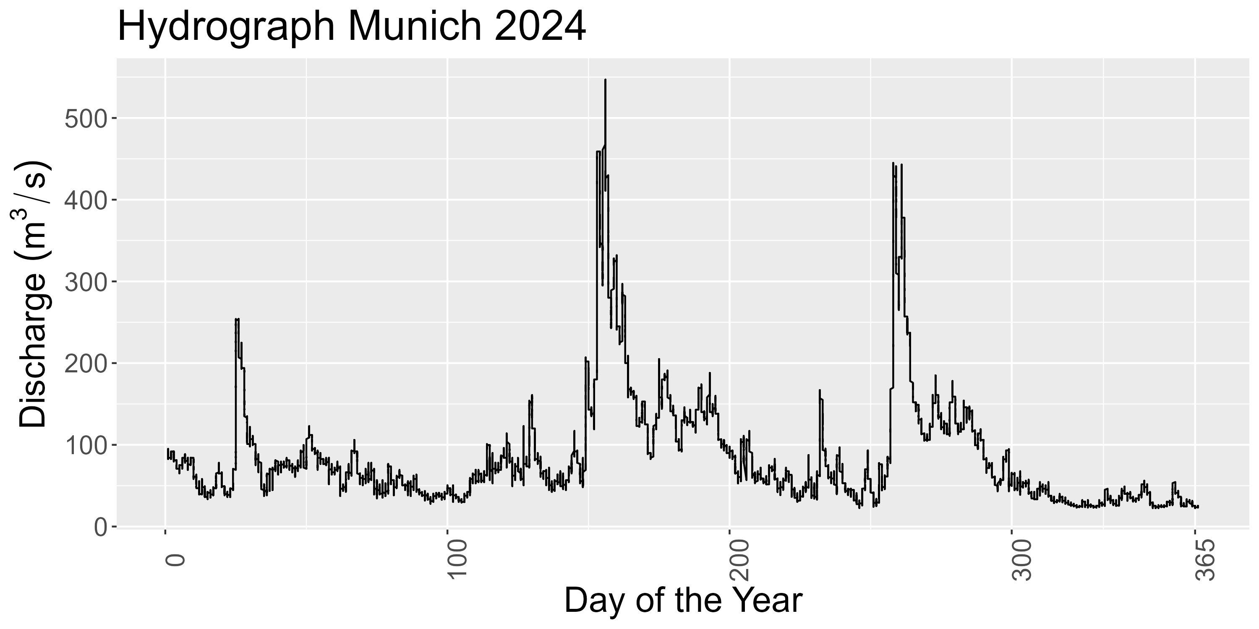
Data – Munich Station
Nival-Pluvial Regime: Peaks in spring (snowmelt) & late summer (heavy rainfall)

Slide 9
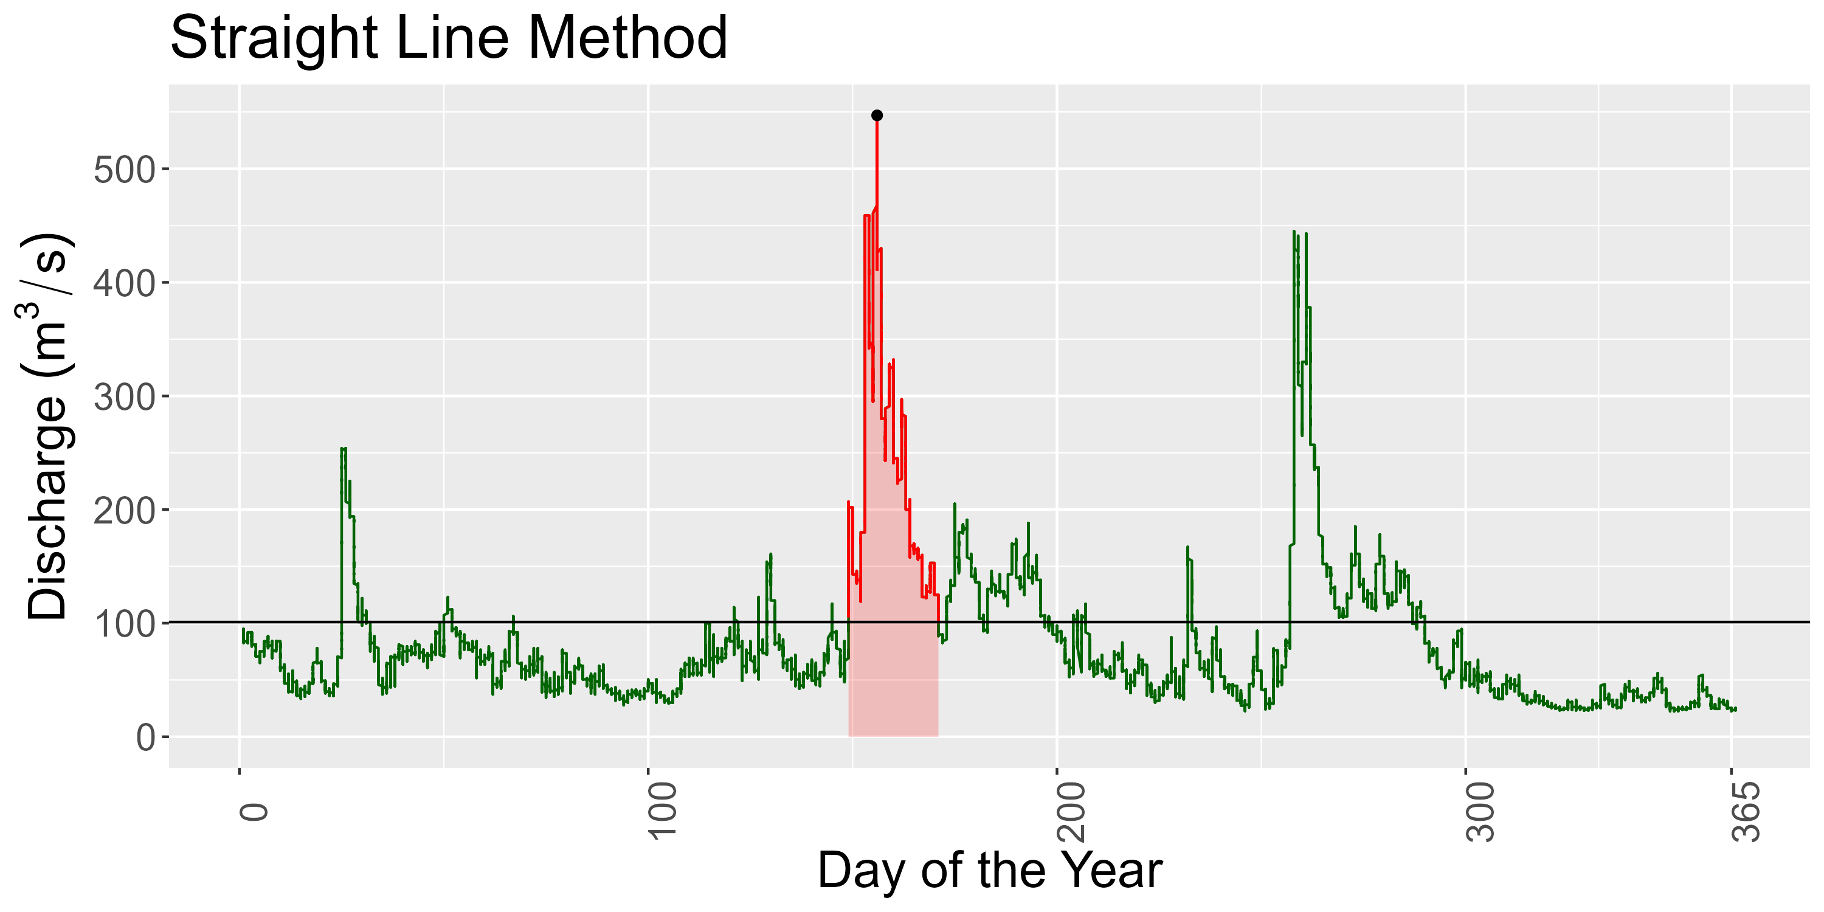
Data – Munich Station
Idea: Define highest flood event per year.
Issue: Absolute value thresholds not applicable for different stations.
Solution: 75%-Quantile approach.
Grimaldi & Serinaldi 2006
Notes:
Contrary to the paper, we do not use fixed threshold
Reason: Fixed threshold is not reasonable IMO bc we are intersted in the dependence strucutre
Dependence structure / correlation is scale independent
Exact values:
Peak: 547
Duration in days: 22.1
Vol in Mio: 446

Slide 10
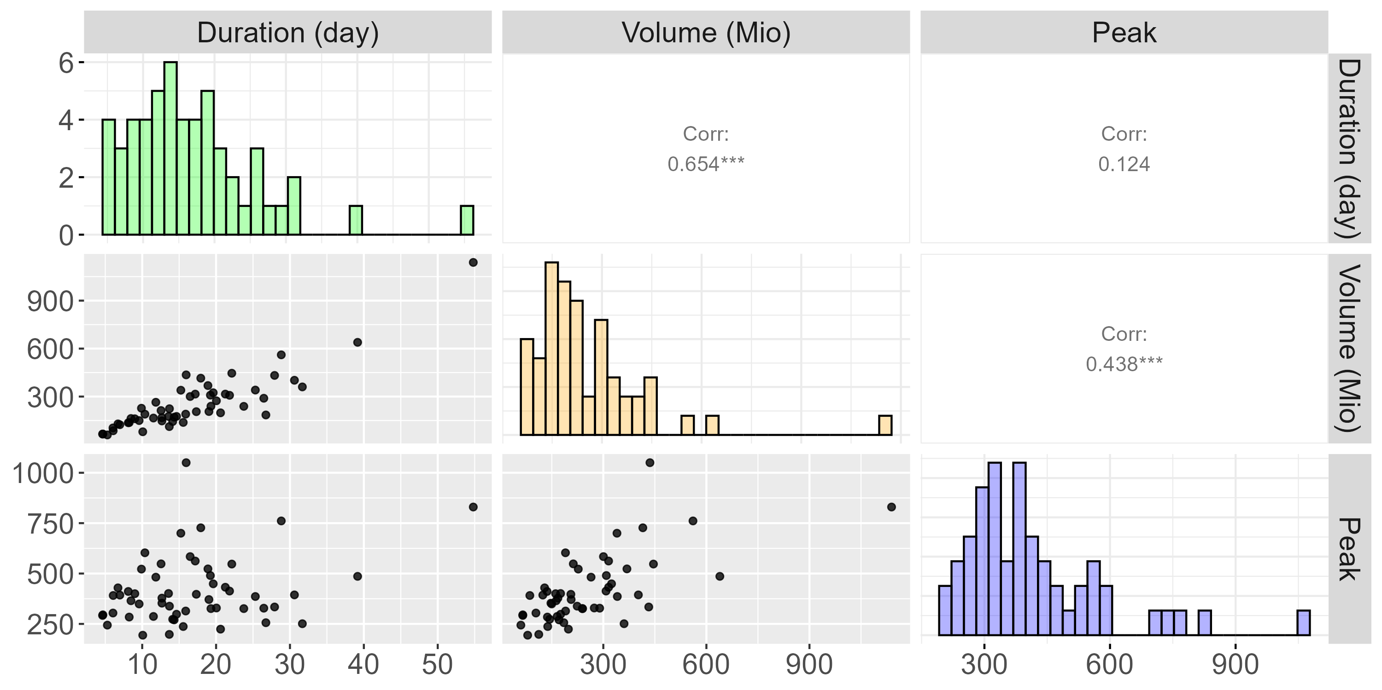
Data – Munich Station
Notes:
Do that for every year to obtain nobs = #years observations
This data used to fit station specific copula

Slide 11
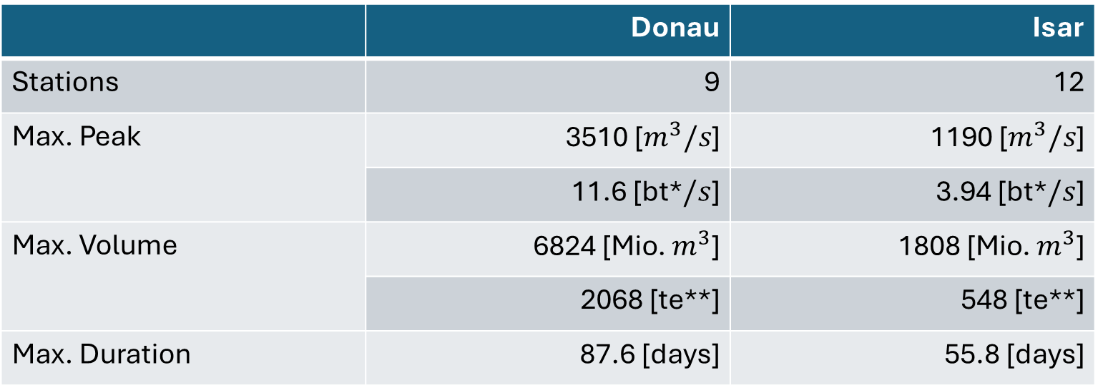
Data – Summary
 | Donau | Isar
Stations | 9 | 12
Max. Peak | 3510 [$m^{3}/s$] | 1190 [$m^{3}/s$]
 | 11.6 [bt*$/s$] | 3.94 [bt*$/s$]
Max. Volume | 6824 [Mio. $m^{3}$] | 1808 [Mio. $m^{3}$]
 | 2068 [te**] | 548 [te**]
Max. Duration | 87.6 [days] | 55.8 [days]
*bt denotes unit „bathtub“
**te denotes unit „Therme Erdingen“
Notes:
2 Rivers, 27 stations where: 6 have below 30 observations -> remove those bc pretty little infor for following methods
After removing: 2 Rivers, 21 stations: Donau: 9, Isar 12
Majority of stations have sample size of 54 with only 2 stations nobs between 44 and 50
In total, we have data on 1122 flood events
Largest observations by river:
Max peak in Donau: 3510 -> that is 11 Bathtubs/s
Max peak in Isar: ~4 bathtubs/s
Max vol in Donau: 6824 -> That is 2068 x Therme Erdingen (Flood took 46 days; in year 1988)
Max vol in Isar: 548 x Therme Erdingen (Flood took 48 days; in year 1999)
Max Duration Donau: 87 days
Max Duration in Isar: 56 days
Duration Reminder: A river is flooded as long as its discharge is above ist 75% quantile;
i.e. It took 87 bzw. 56 days for the discharge to drop below the 75% quantile within that year

Slide 12
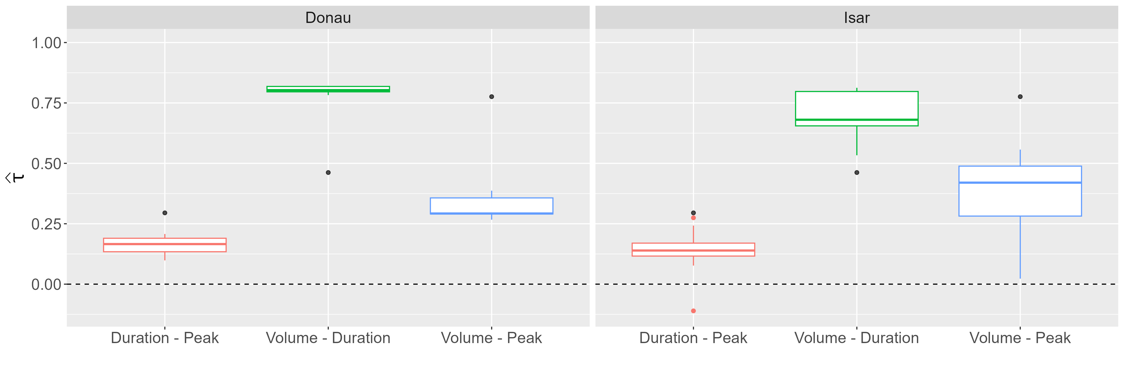
Data – Correlation
Notes:
Boxplots:
Distribution for all Kendall Correlation Coefficients
Tau higher variation in Isar, one correlation even below 0 (Mittenwald)
Important to note: There seem to be three distinct correlation values / three distrinct strength of dependence (Like already seen for Munich station)
Volume-Duration largest by far, then Volume-Peak, then Duration-Peak. This holds for both rivers
The Black Dots the taus observed in the paper. And as seen in the paper, the degree of dependence between these variables depends on the threshold of when a flood is considered as such
Different to the paper: We choose quantiles to define a flood, paper used fixed value
For large threshold, Peak-Volume dependence INCREASES while (paper p 1162) while for others
That is, the behavior we saw for the Munich station does also hold for the other stations
This is VERY important because it implies the violation of NACs
Here critizing the paper:
The paper applies NACs without every showing scatterplots or the correlation among the variables. When comparing our analysis to their, we missed those
Thus, we are uncertain if NACs were applicable to the data in the paper?
In our simulation study we will see what happens if NAC applied to vine DGP
>> This brings us to methods part ☺

Slide 13
Methods
Archimedean Copulae
(Fully) Nested Archimedean Copulae
Vine Copulae
Notes:
We apply copulas
Quick reminder:
Copula is a joint cdf with uniform margins (more on that later. For now think of it as just a function)
Allows to decouple marginal distribution and dependence strucutre
Copulas are how multiple weels to tweak:
Symmetry in a copula
Here: Focus on Archimedean copula → These are exchangeable (More on that during generators)
Speaking of generators:
Generators define the family a copula is from (Again, more on that on another slide)
These properties refer to bivariate consideration. We consider trivariate copula
Building blocks of trivariate copula is still the bivariate copula
Different Nesting / Conditioning Structure give different Copula
We consider three type of trivariate copulas
Goal here: Copulas are math heavy
Usually you will see „Sklar‘s Theorem“ on which copulas are based on
Goal here: Keep low in math
Thus: Start with the building blox and of bivariate copula and go deeper into the aforementioned propertie

Slide 14
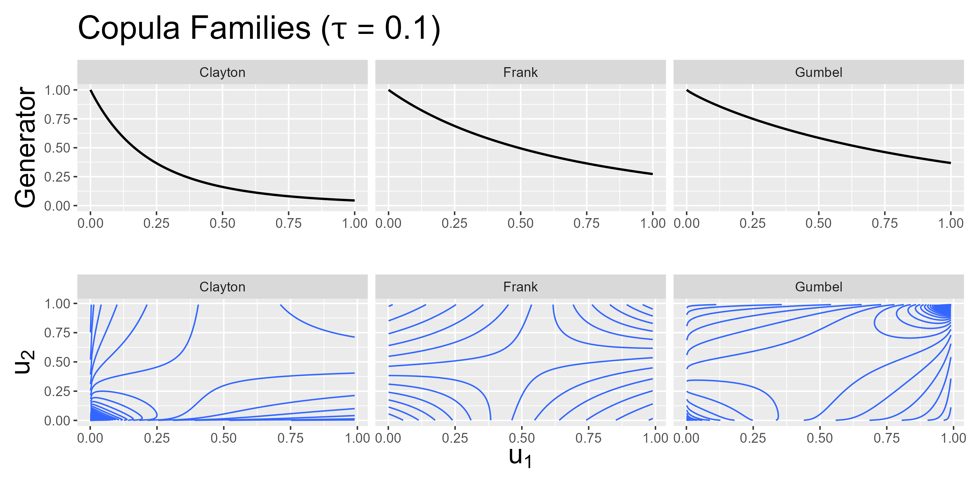
Methods - Generators
Notes:
What are Archimedean copulas? What is exchangeability? And what is a copula family?
Before diving into these questions:
Consider the axes of the plots. They reach from 0 to 1.
This is because, before applying copulas, we transform our data using PIT
Discussed this in Interim meeting
If not remeber it: Just know there exists a function such that we can always transform our data into the 0,1 domain
Everything that follows is applied to this transformed data
Now, what are Archimedean copulas:
Copulas defined by a generator function
We focus on three different archimedean copulas: Clayton, Frank and Gumbel
You can see their generators on the top row
Imagine generator functions as building blocks of an archimedean copula
You plug in the transformed variables into these functions and jointly this gives you the final copula (See Archimedean copula in generator functions later on)
Generator functions depend on a parameter value and estimating a copula means we estimate this parameter of the generator
Finally, since copulas describe the dependence structure in the data:
Copulas are connected to correlation
That is, the PARAMETER of the generator function is connected to the correlation in the data (thus, tau = 0.1) on the top
What are are Archimedean copula families
Depending on the generator function, the contour plot on the bottom change
But more on that later, when we consider higher correlation
Then, effect of family / generator function is more clear
Finally, what is exchangeability:
In contour plots, imagine a line from bottom left to top right
This is the axis for which the contour plots are symmetric
This implies that the order in which the variables are plugged into the copula do not matter (More on that when considering AC)
Learning now that generators exist, we can further talk about copula families
Gumbel, Clayton, Frank
Each family defined by is generators
Generator depends on one paramter bzw. on tau
> Estimating this parameter / tau and asuming a copula family gives full BIVARIATE dependence structure
> Plot each and discuss properties / tail dependence
!! Add 1-u and survival copula into appendix!
! Explicitly mention the x –axes in both plots

Slide 15
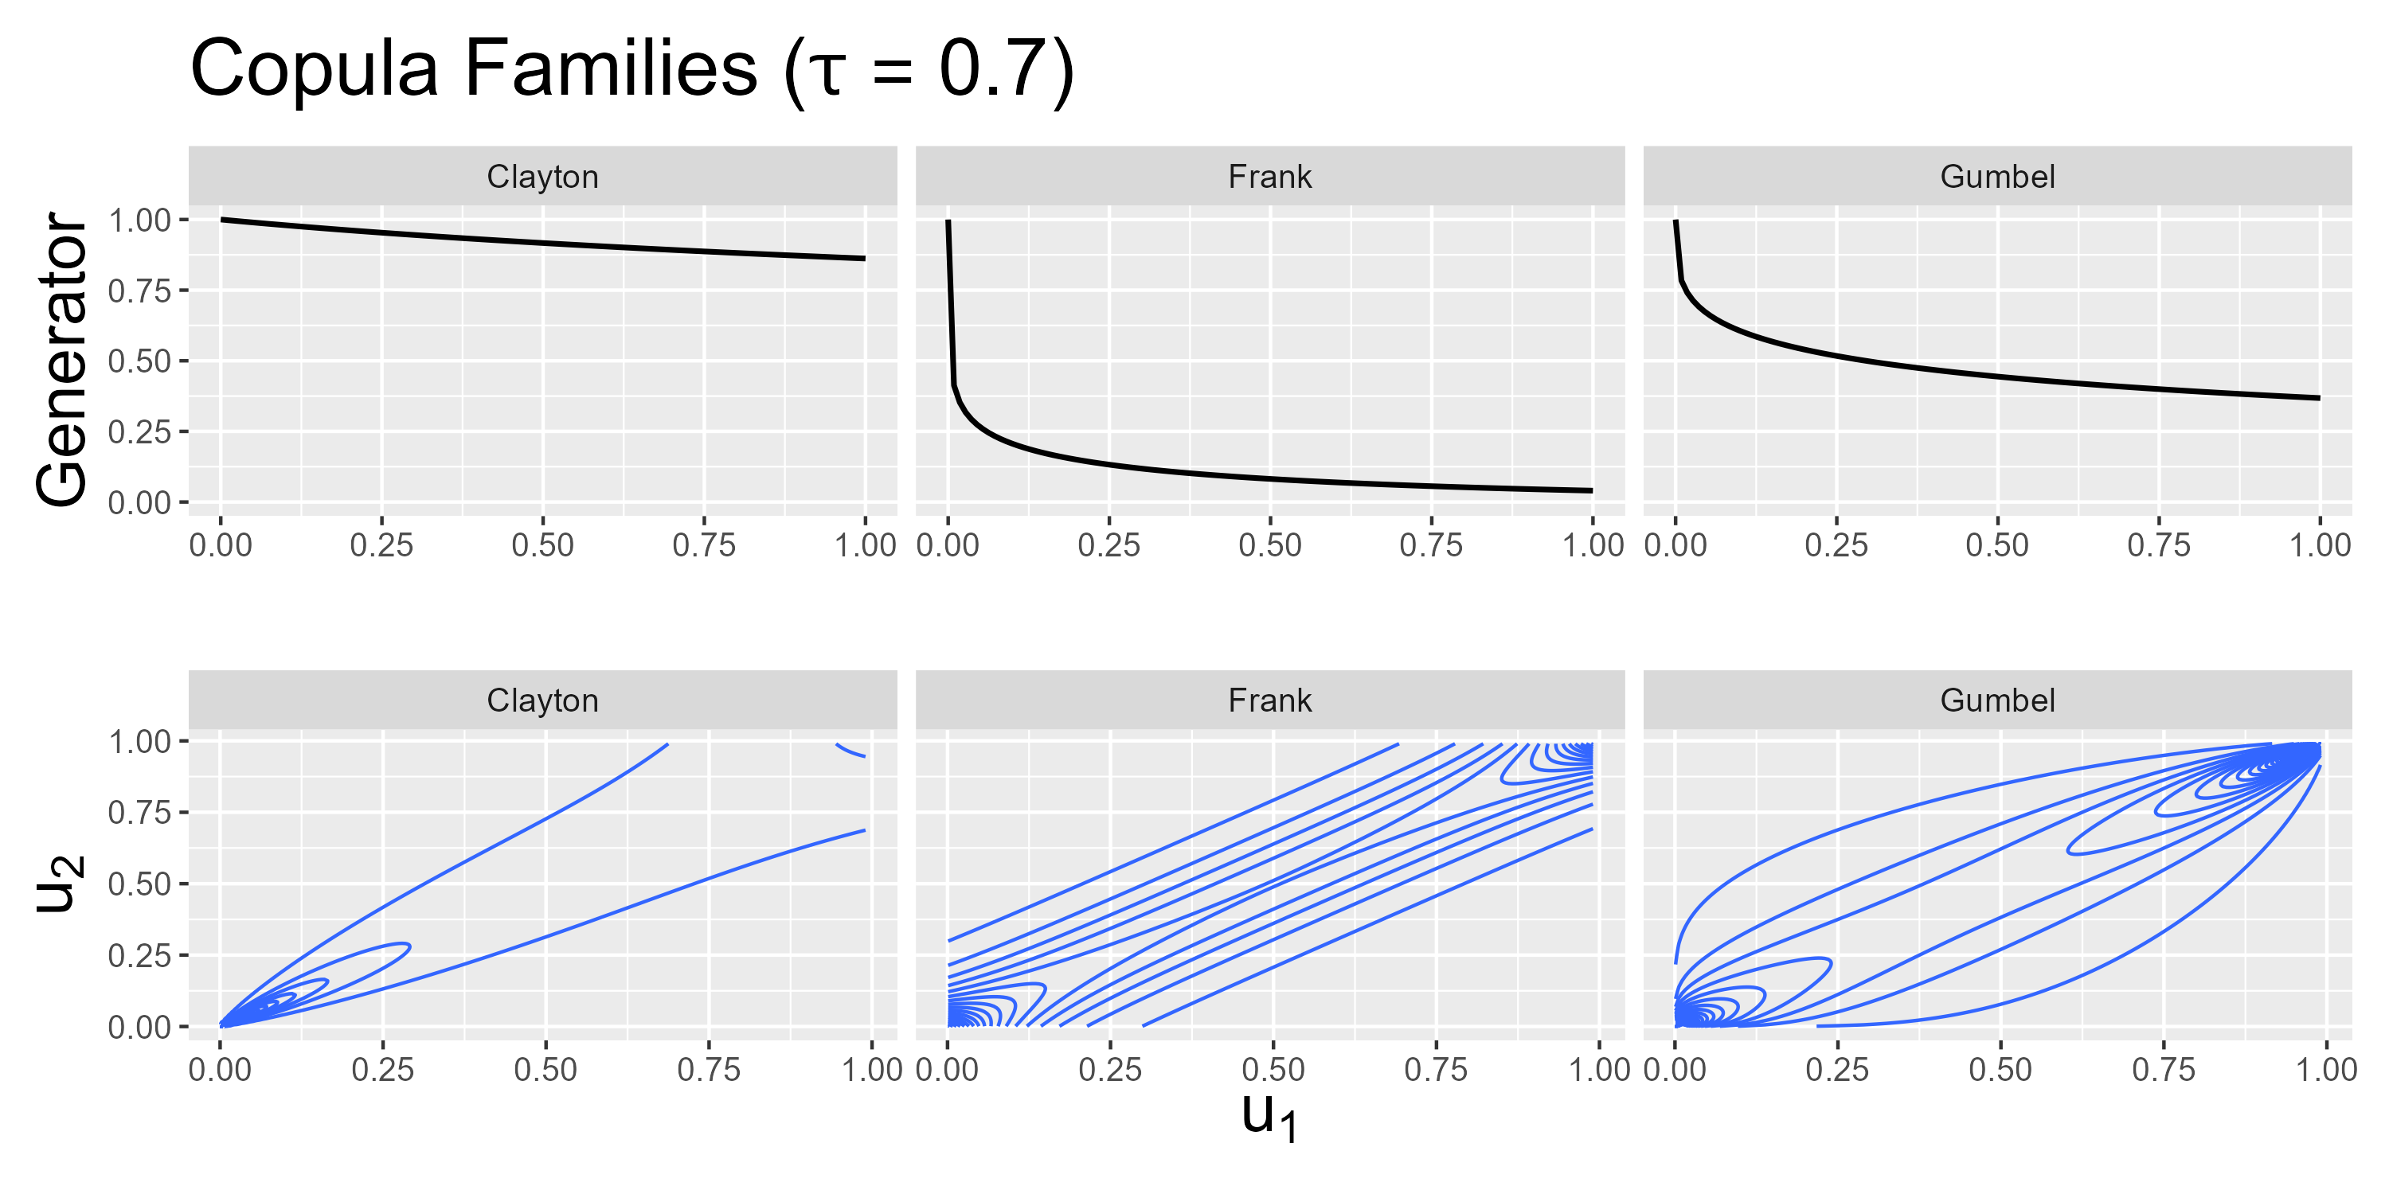
Methods - Generators
Notes:
Consider what happens if the dependence increases (i.e. when tau increases from 0.1 to 0.7)
The behavior of the generator changes
Thus: DENSITY Contour plots change
Now the difference between copula families is more clear, especially, the implied behavior of the data for extreme values
Clayton (left): For low values of u_1, u_2 also tends to have small values. This is not the case for large values → LOWER taildependence
Gumbel (right): For high values of u_1, u_2 also tends to have large values. NOT THE CASE FOR SMALL VALUES? → UPPER taildependence
Frank (center): No dependence for low, nor for high values → NO taildependence
General tail dependence: „Tail dependence describes the likelihood that extreme values of two (or more) random variables occur together. “
So we established what we can tweak in a bivariate case
That is, we know about the building blocks for a trivariate copula
The structure in which we can combine these bivariate copulas to obtain a trivariate copula is now discussed

Slide 16

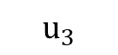
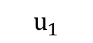
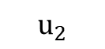
Methods - ACs
$$C\left(u_{1},u_{2},u_{3}\right)=φ^{[−1]}(φ\left(u_{1}\right)+ φ\left(u_{2}\right)+ φ\left(u_{3}\right))$$
$$C$$
$$u_{1}$$
$$u_{2}$$
$$u_{3}$$
Notes:
The simplest trivariate case is trivariate AC
3 things to notice:
On top: This is how the generator function phi is used to build a Archimedean copula
Number of generator functions used / copulas you see in the tree is the number of possibly unique dependence structures
Here: We have this one C in the tree that is the AC implies all three variables have the same dependence
Also: Exchangeability: Changing the order of how we plug in the us does not change the value of C
This implies a limitation on the data:
Assuming that the true copuls is of simple AC, the data needs to suggest the same type AND strength of dependence between variables
(Also strength, bc one generator function is used and the parameter of generator depends on strength of dependence)
For us: Fitting a simple AC implies assumption that correlation between peak, volume and duration is identical

Slide 17

Methods - NACs
$$C\left(u_{1},u_{2},u_{3}\right)=C_{1}\left({u_{1},C}_{2}\left(u_{2},u_{3}\right)\right)$$
$$C_{1}$$
$$u_{1}$$
$$C_{2}$$
$$u_{2}$$
$$u_{3}$$
Notes:
NACs: As name suggests, we nest copulas
In trivariate: We nest the bivariate copulas resulting into the tree above
Applying number of copulas = number of unique dependence:
For THREE variables, we can only display TWO unique dependence structure
Limitation here:
Partically exchangeability: Order in which we plug u2 and u3 in does not matter
Thus: Applying NACs implies assumption hat two dependence structures in the data is the same
As seen in data part, this is not the case
Thus, we extend the paper copula approach by VINE copulas
Also paper citique here:
They applied NACs even tho (black dots in boxplots) assumptions were too restrictive

Slide 18
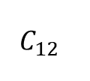
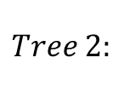
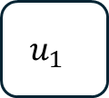
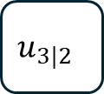
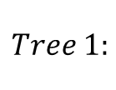
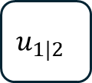
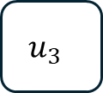
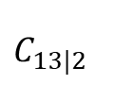
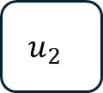
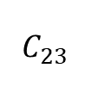
Methods – Simplified Vines
$$c\left(u_{1},u_{2},u_{3}\right)=c_{12}\left(u_{1},u_{2}\right)c_{23}\left(u_{2},u_{3}\right)c_{13|2}\left(u_{1}\left|u_{2},u_{3}\right|u_{2}\right)$$
$$C_{12}$$
$$C_{23}$$
$$Tree 1:$$
$$u_{1}$$
$$u_{2}$$
$$u_{3}$$
$$C_{13|2}$$
$$Tree 2:$$
$$u_{1|2}$$
$$u_{3|2}$$
Czado 2019.
Notes:
Note, the above function now is the copula density
Obtain the copula itself by integration, but just a side note. Not really relevant now
Vines
No nesting of copulas
Instead: 3 bivariate copulas with one being a conditional copula
Applying # cops = # unique dependence → We have 3 unique dependence structure that is, we can unique model every dependence structure in the data!
i.e. NO limitation for dependence strcutre → Well suited for our case as seen before from the correlation boxplots
Takeaways / Expectation:
Seen from data, we anticipate 3 different strength of dependence
We expect Acs and NACs to be infeasible for this reason
To examine vine performances – in case underlying is NAC even tho we think it is non-NAC – run simulation
Also, can validate paper results PLUS extend their results: They only compared AC vs NAC, now we extend this by comparison of NACs vs vines

Slide 19
Simulation – Setup
Parameter | Value
 | NAC DGP | Vine DGP
Sample size | 15, 30, 50, 1000
Correlation* | Donau: (0.18, 0.32, 0.81) Isar: (0.13, 0.38, 0.69) Low-High-High: (0.10, 0.80, 0.80) Low-Med.-High: (0.10, 0.50, 0.85)
Iterations per setup | 4000 | 27000
Copula Families | Gumbel, Clayton, Frank | G-G-G, G-G-C, G-G-F, …
*Correlation structure for NACs obtained by building average over the two larger correlation values
Czado 2019.
Notes:
Fit AC, NACs and vines for different seetings
Setting 1: NAC DGP
Used to reproduce paper‘s findings (paper compared NAC performance vs Vine performance)
Used to see how Vines perform if NACs are true
Setting 2: Vine DGP
Our data suggests 3 different dependence structures
See how vines perform and apply similar analysis as paper did, but to NACs under true vine structure
For each setting:
Varying sample sizes:
Number of observations our copula estimation is based on
Reference here: Some copulas had below 30 observations. We filtered these out leaving us with mostly 50 observations each.
Thus:
50: Our data set size, how would these fit perform
15 and 30: How does fit perform for smaller data sets
1000: How does fit perform for large data set
Varying correlation structures:
For two of the correlation structures, we used average correlation for the rivers
Gives feeling for performance assuming we somewhat got a glimpse of the underlying correlation
LowHighHigh: One low, two similar and high correlation values
LowMedHigh: One low, one medium and one large correlation value
Chosen these two because during our simulation we found that due to model restriction in NACs, there emerges a bias depending on the difference in the two smaller correlation values
Also: No negative correlation, because no negative correlation in data (except that one outlier) and negative corr in copula can be turned into positive ones using 1-u
Varying copula families
For NACs, the underlying model was allowed to be only of one trivariate family
For Vines, every copula was allowed to be one of the 3 copula families
This family set up leads to the number of iterations we fitted the models:
For NAC, setup = c(n, family) → Fitted each of these combination 3k times
Leads to each c(n, family, correlation) was fitted 750 times
(about 750 times bc I selected correlation structure by random)
Note: 750 was not intended. I aimed for 1k, but finishing this presentation, I realized I set B too small (historically I only had 3 correlation structures)
For Vines, we fitted each setup 1000 times per family combination. There are 3 families and 3 dependence structures → 3^3 = 27 → B = 27 * 1000
Copula selection within each setup was done using AIC
Note on correlation:
NAC: average large values for inner and keep smallest for outer
Vine: 1-2-3, T2: 1|2-3|2 where 1-2 has largest, then 2-3, then 1-3

Slide 20
Simulation – Results
If true model is NAC, Vines still perform well (Evaluated this using KLD)
Reason: Vines more flex than NAC
Reproduced paper results if true is NAC and AC applied + extended this for smaller samples
i.e. AC tau underestimates true dependence structure
If true model is vines, NACs perform worse depending on the correlation values of vines
Reason: NACs systematically overestimate the correlation strength
That is: Outer tau is closer to 2nd largest vine tau
LOLOLOL Slide is shit. Fix after checking if we use plots or not

Slide 21
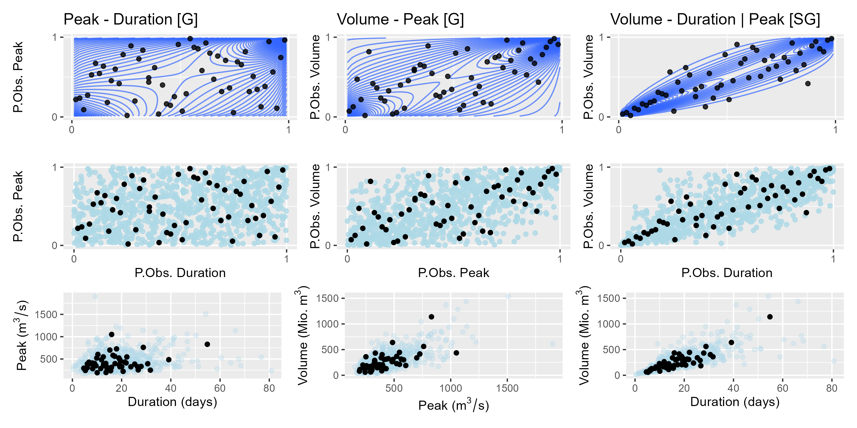
Results – Visual GoF
Notes:
Now, we fit multiple vine models and select according to AIC
This is result for Munich station
Top row: Contours of fitted copula density
Center row: Synthetic data generated by fitted copula
Bottom row: Re-transformed synthetic data
Details:
Peak – Duration and Volume – Peak are Gumbel copulas
Volume – Duration is the conditional copula and is Survival Gumbel

Slide 22
Results - Taildep

Slide 23
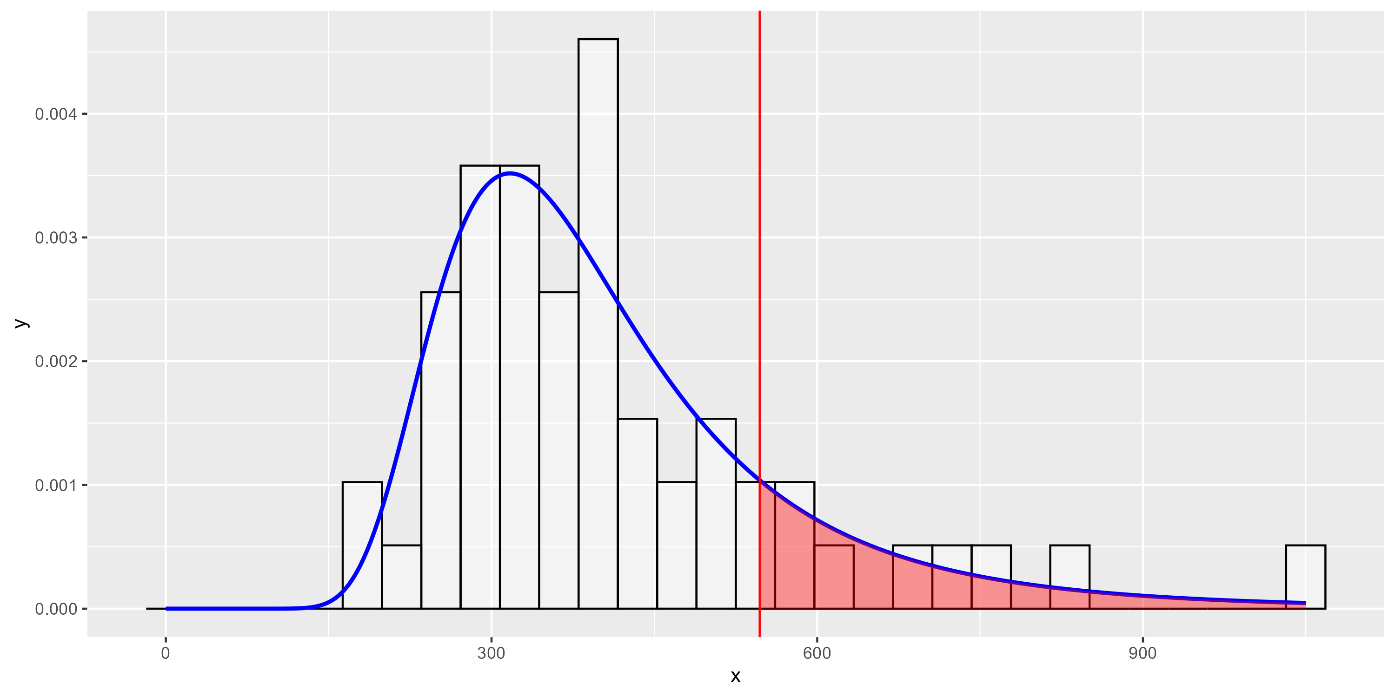
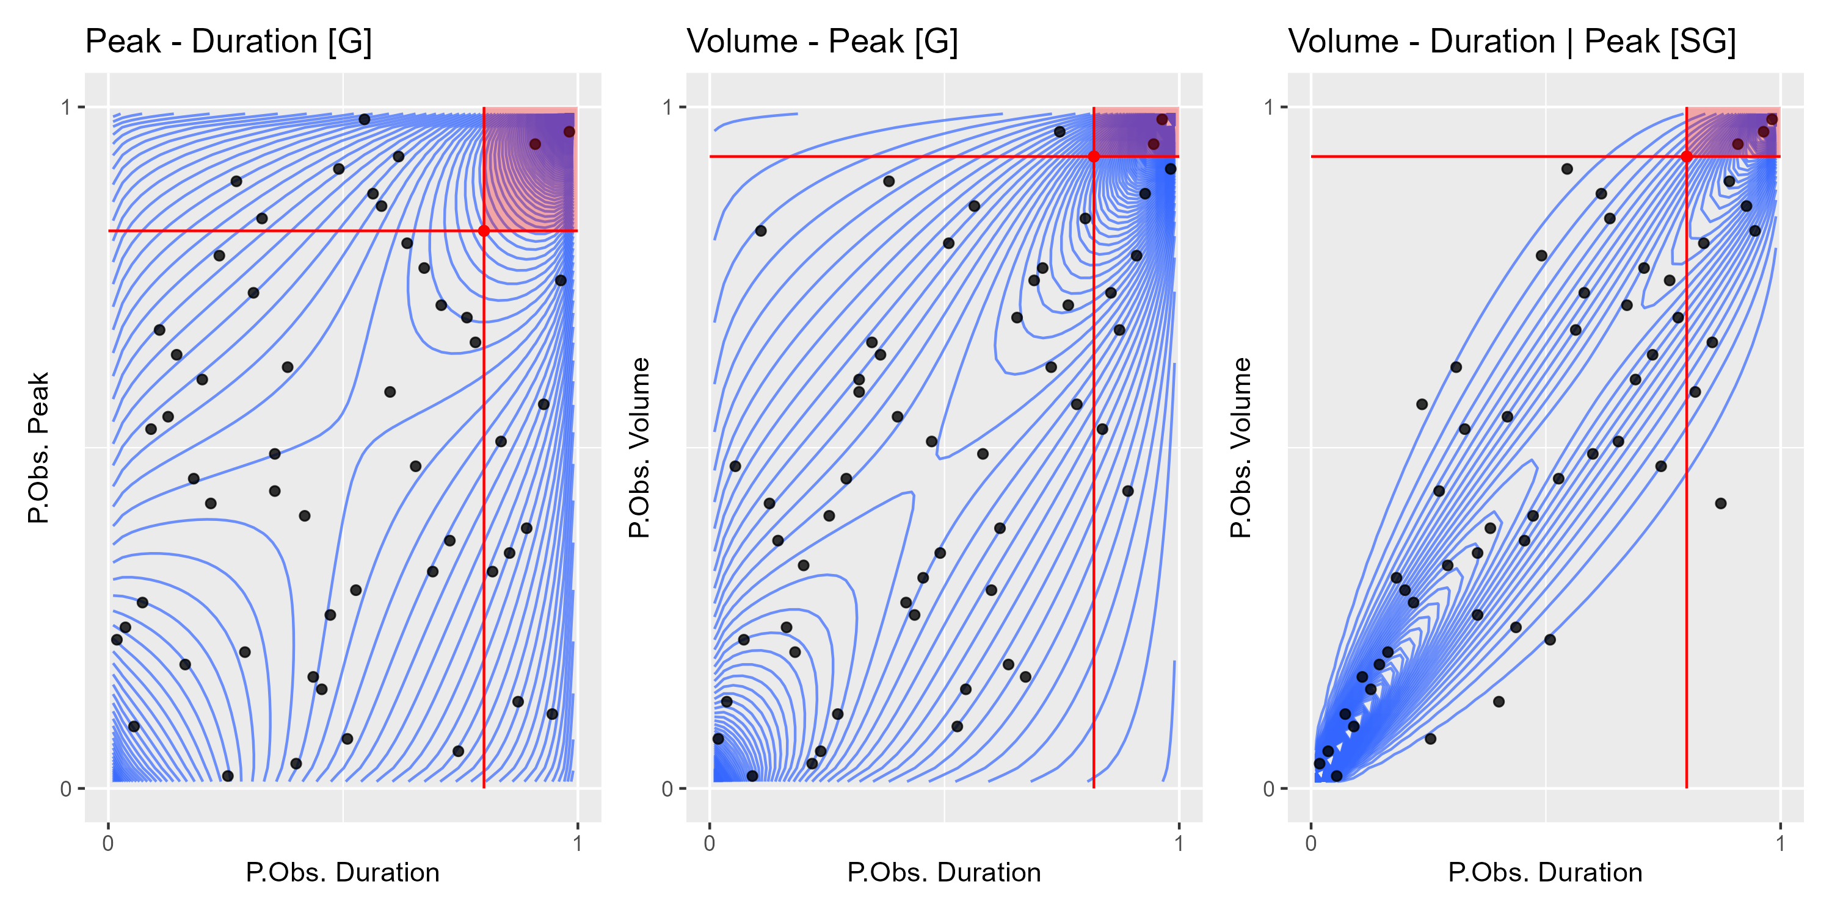
Results – Connection hydro lecture

Slide 24
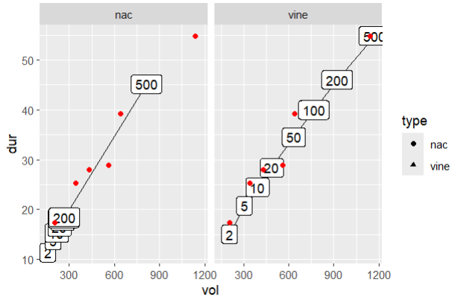
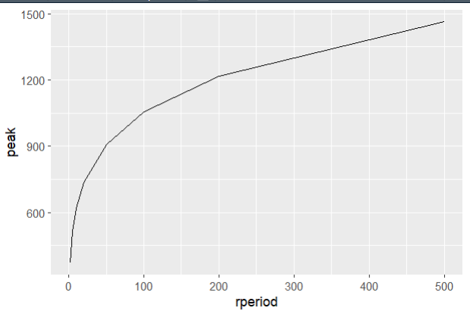
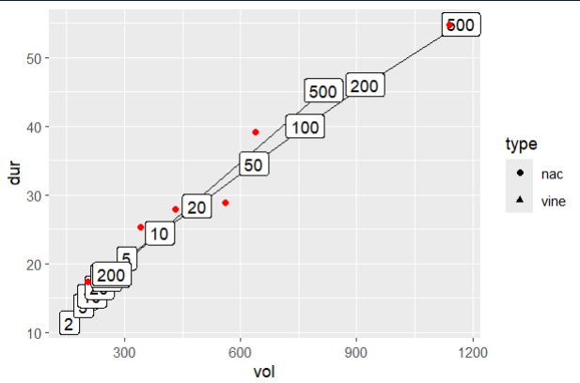
Results – Cond distr plots

Slide 25
Results – The Issue

Slide 26
Discussion
Analysis focused only on one station and we do not need multiple stations at all (same as paper) Reason: Lack of data → We would like to apply a GAM model to tau while fitting a copula (gamCopula) For this purpose, we require multiple stations. This is more of an outlook + reason why we introduced multiple stations tho….
Solved the problem of jointly consideration of trivariate case, but moved the problem to estimating a marginal fit that is good

Slide 27
Summary
Simulation:
NACs overestimate dependence if true Vines

Slide 28
Sources
Bayerische Staatsregierung (BS, 2025): Pressemitteilungen. URL: https://www.bayern.de/hochwasser-bayern-2024-fueracker-bayern-fordert-versprochene-solidaritaet-des-bundes-ein-angekuendigte-bundesmittel-fuer-hochwasserschaeden-in-bayern-bislang-ausgeblieben-finanzausschuss-des/#:~:text=Nach%20vorl%C3%A4ufiger%20Sch%C3%A4tzung%20belaufen%20sich,2%20Milliarden%20Euro%20versichert%20waren. (as of 03/16/2025).
Czado C. (2019): Analyzing Dependent Data with Vine Copulas A Practical Guide With R. Cham, Switzerland.
Gewässerkundlicher Dienst Bayern (GKD, 2025): Abfluss Bayern. URL: https://www.gkd.bayern.de/de/fluesse/abfluss (as of 03/16/2025).
Grimaldi S., Serinaldi F. (2006): Asymmetric copula in multivariate flood frequency analysis. In: Advances in Water Resources, 29, 1155-1167.
Khajehali M., Sfavi H., Nikoo M., Najafi M., Alizadeh-Sh R. (2025): A copula-based multivariate flood frequency analysis under climate change effects. In: Nature Scientific Reports, 2025, 1-16.

Slide 29
Appendix

Slide 30
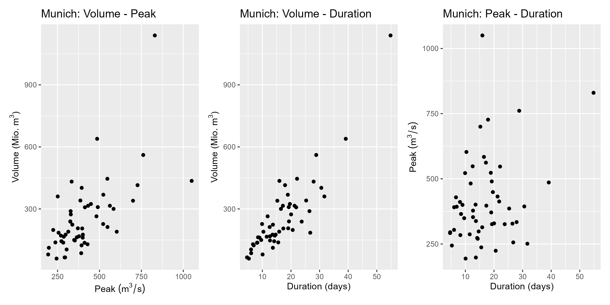
Appendix

Slide 31
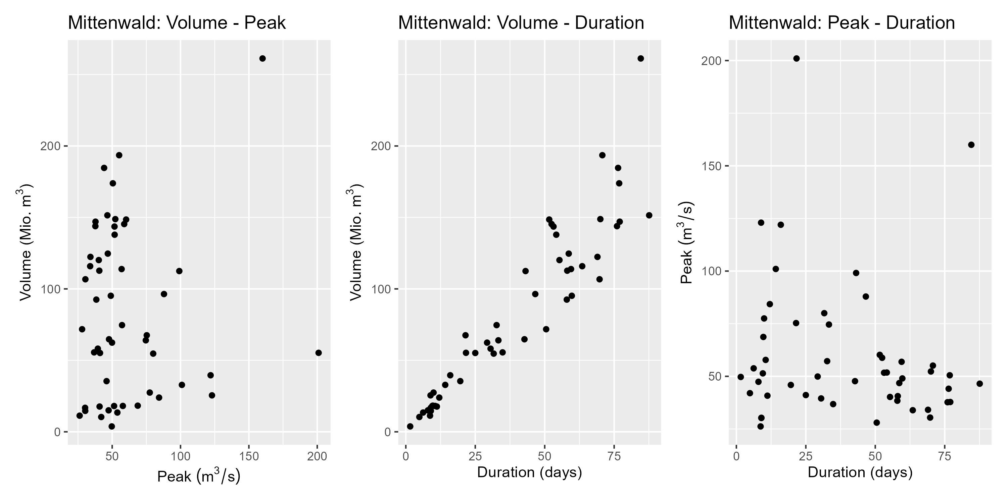
Appendix
Notes:
Negative correlation for duration-peak

Slide 32
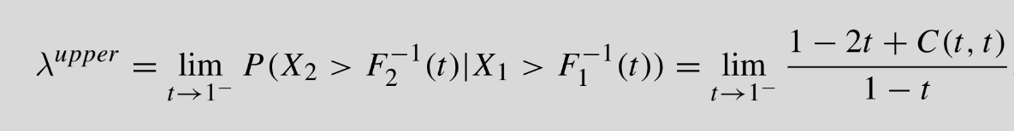
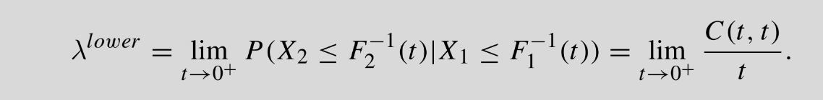
Appendix – Tail Dependence
Notes:
Sorry for this slide… It‘s just a backup and putting this into PPP is a pain
Czado p. 34

Slide 33
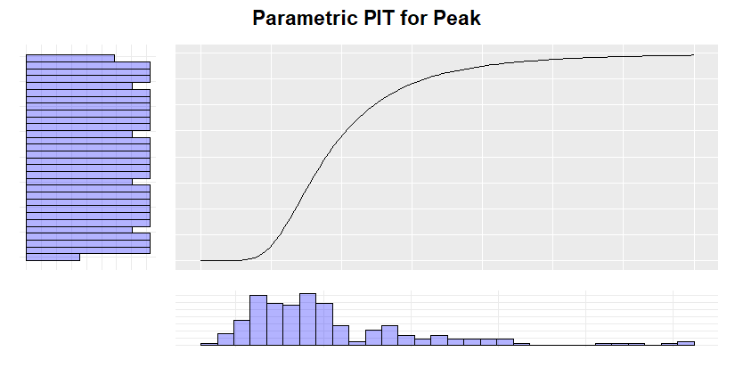
Appendix - PIT
Notes:
Concept of PIT:
We used empirical CDF
> Then, CDF is step function and not smooth
> The transformed variables are „psuedo obs“

Slide 34
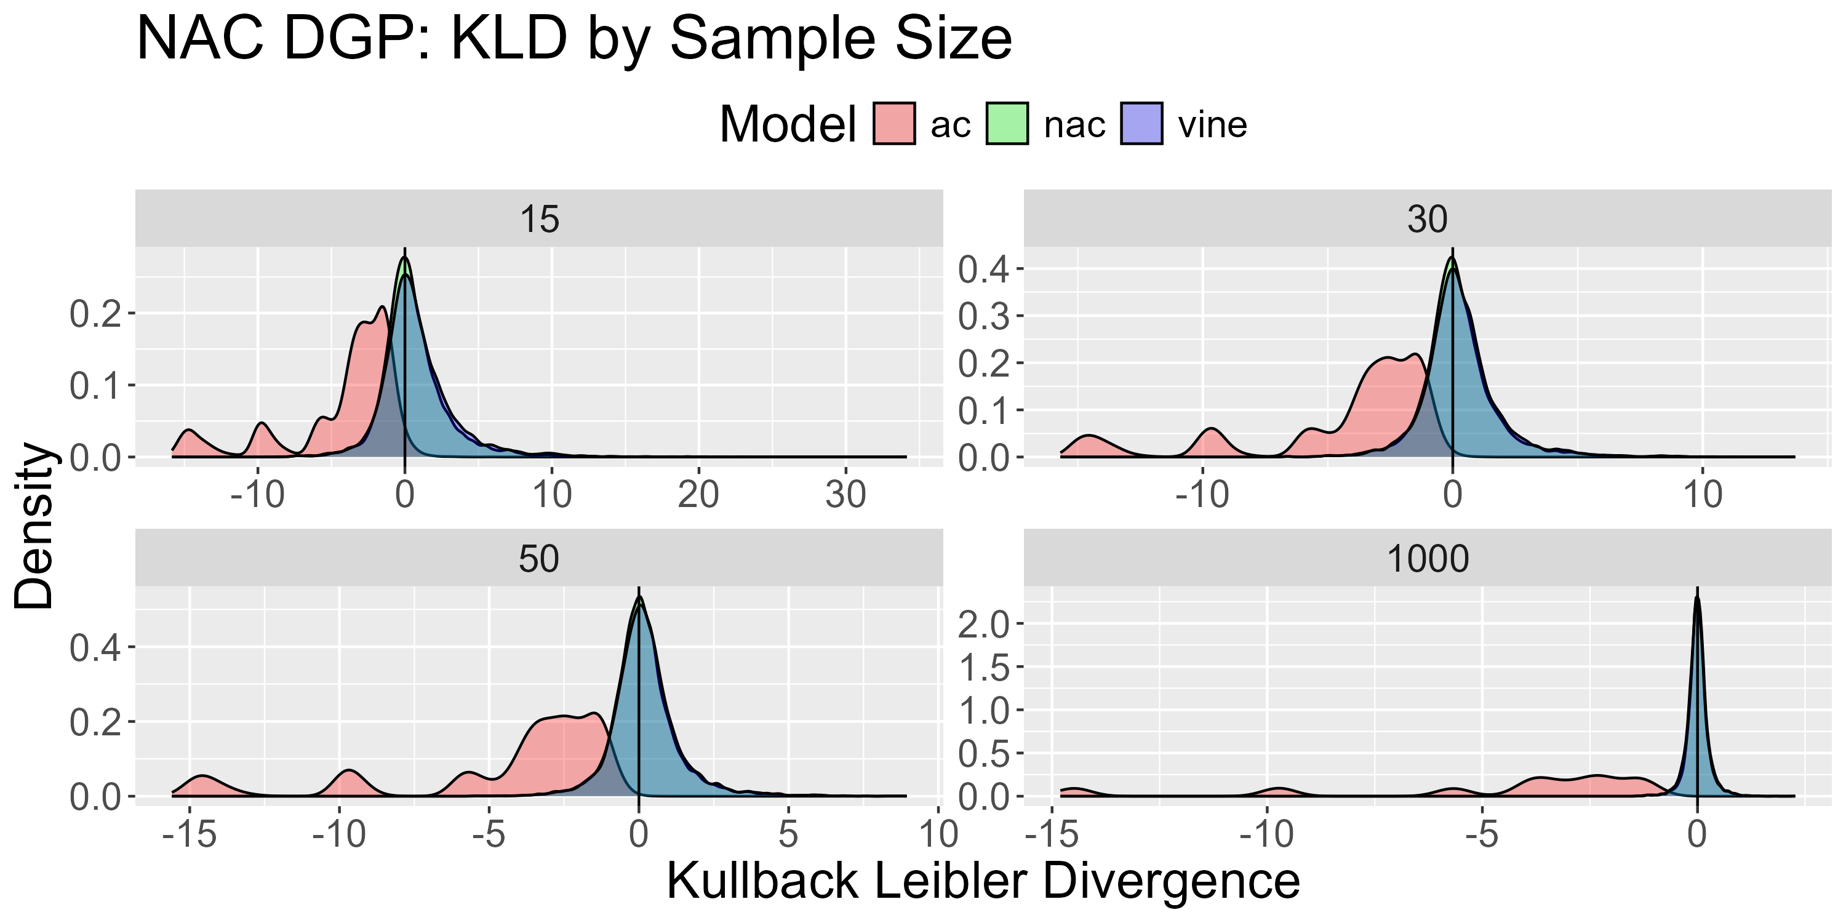
Simulation – NAC DGP
Notes:
Describe plots:
For each of run, we proxied KLD (MonteCarlo Method)
You see this proxi separated by sample size
Optimal: KLD of 0 → Density with high peak at 0 and small variance desirable
Systematic deviation from 0 shows bias
High variance shows low precision / high variance in model fit
We see:
Green / NAC and Blue / Vines pretty much look identical for every sample size:
Both close around 0 with similar variance
For increasing sample size, the underlying dependence structure is pretty well proximated
AC looks really bad: Not centered around 0 with large variance
Performance explained:
AC due to restriction
NAC are true and expected to performe well
Vines are more flexible than NACs → They can capture this partial symmetry
Important Takeaway:
Even if underlying structure is NAC, Vines performe quite well
Reason I mention this:
In our analysis, we will focus only on the fitted vines
This is not only due to the evidence of NACs not being suitable, but also because, as we see here, vines are perfectly fine even if NACs were true

Slide 35
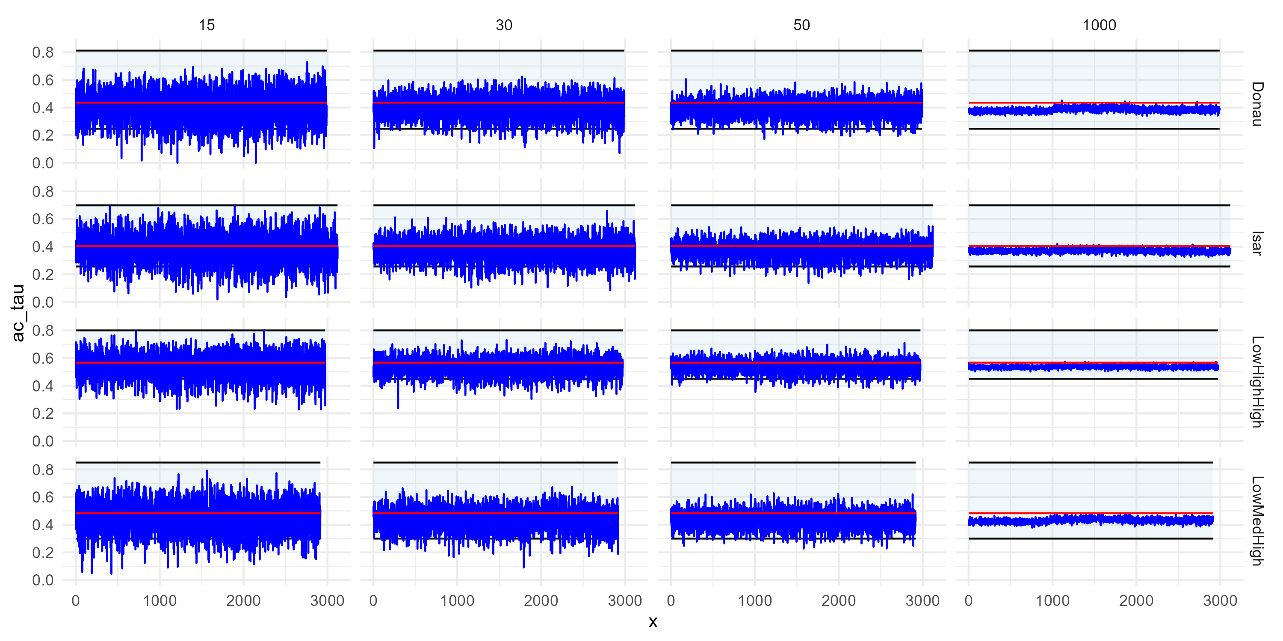
Simulation – NAC DGP
Notes:
Reproduce paper result
For n = 5k, tau estimated by AC is not larger than ~1/3 of area
→ We did not run 5k sims, but
A) We can confirm behavior for around 1k
B) For smaller n, we cannot confirm this limit, but a clear bias towards the lower correlation value
Takeaway:
If AC applied to NAC, we systematically underestimate dependence structures
Discussing this bc
A) To confirm paper
B) Questions arisis what happens if NACs are applied to Vine DGP
i.e. What bias does the paper have due to applying NAC to something that does not look like it suffices NAC assumption

Slide 36
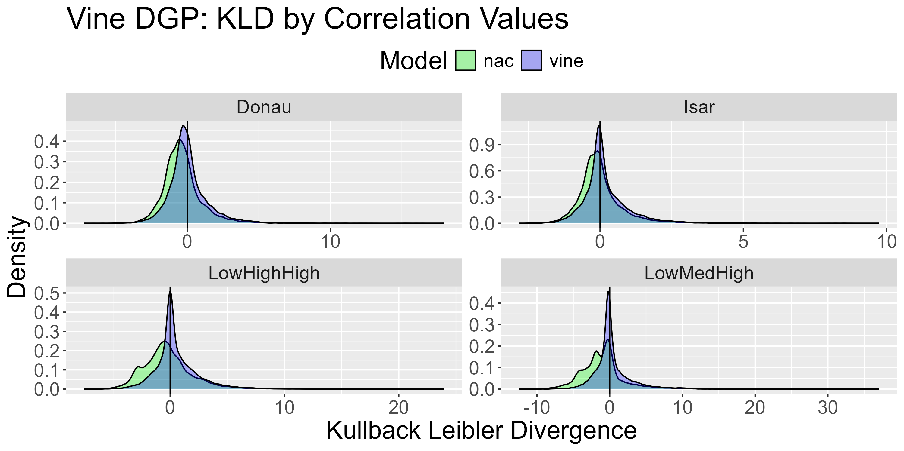
Simulation – Vine DGP
Notes:
For Vines, we again consider KLD
BUT: Instead of by n, consider by correlation structure
Reason: By n hints to large sample behavior and we would see that NAC do not perform as great as vines for large n
(in case interest, we can look at that plot later, ist in appendix)
Instead: Directly look at reason why NACs do not perform well for large n:
NACs performe remarkably worse than vines now that we have 3 different correlation values
And more interestingly:
The more different these correlation values are, the worse the bias.
Obvious reaosn: NACs can only capture two different correlation strength, if we have 3, it just cannot capture that it
That being, if we have 3, but 2 of them are very similar, then NACs seem to work fine as there is not a sever issue when modelling two barely different structures as one
Intersting now:
Same as for AC, in what direction is the bias of NACs?
Bzw. What happens to the 3rd dependence structure when only 2 are available in NAC

Slide 37
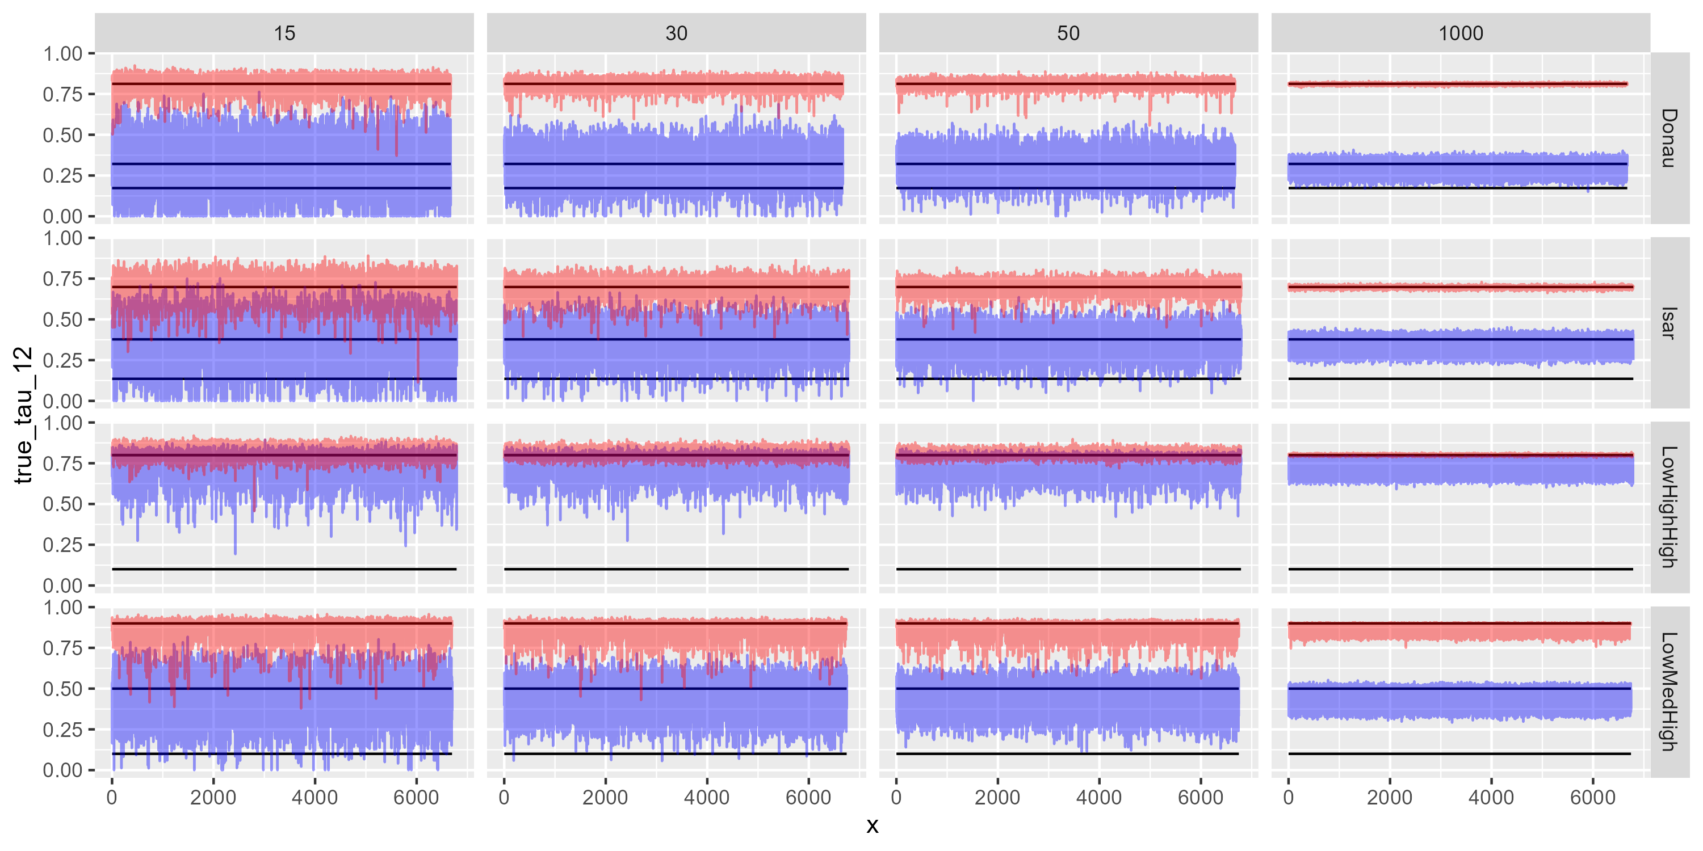
Simulation – Vine DGP
Notes:
- Overestimation NAC

Slide 38
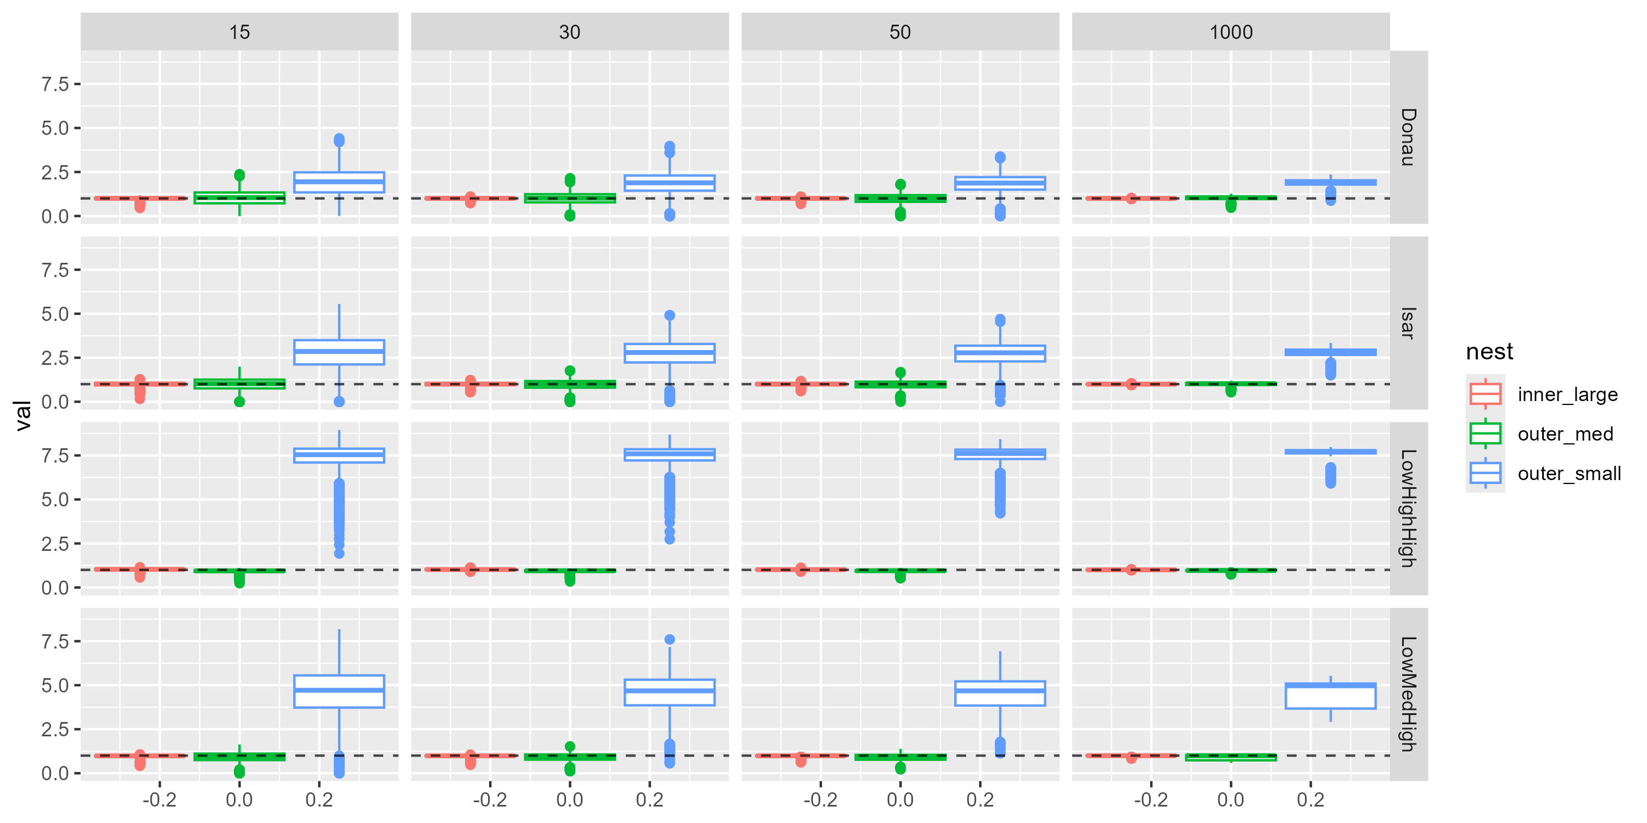
Simulation – Vine DGP
Notes:
- AIC discussion

